Slide 1
Solidity Contracts
Loke KS

Slide 2
Introduction
Solidity is an object-oriented, high-level language for implementing smart contracts. Smart contracts are programs which govern the behaviour of accounts within the Ethereum state.
Solidity is a curly-bracket language. It is influenced by C++, Python and JavaScript, and is designed to target the Ethereum Virtual Machine (EVM).
Solidity is statically typed, supports inheritance, libraries and complex user-defined types among other features.
With Solidity you can create contracts for uses such as voting, crowdfunding, blind auctions, and multi-signature wallets.

Slide 3
Introduction
The primary purpose of Solidity is to write smart contracts for Ethereum. Smart contracts are the basic unit of deployment and execution for EVMs
A contract in the sense of Solidity is a collection of code (its functions) and data (its state) that resides at a specific address on the Ethereum blockchain.
Generally, smart contracts are composed of at least two constructs— variables and functions

Slide 4
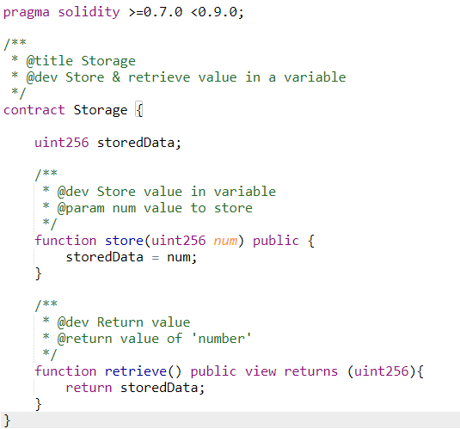
Introduction
The line uint storedData; declares a state variable called storedData of type uint256 (unsigned integer of 256 bits).
You can think of it as a single slot in a database that you can query and alter by calling functions of the code that manages the database.
In this example, the contract defines the functions set and get that can be used to modify or retrieve the value of the variable.

Slide 5
Contract
This contract allows anyone to store a single number that is accessible by anyone in the world without a way to prevent you from publishing this number.
Anyone could call set again with a different value and overwrite your number, but the number is still stored in the history of the blockchain.

Slide 6

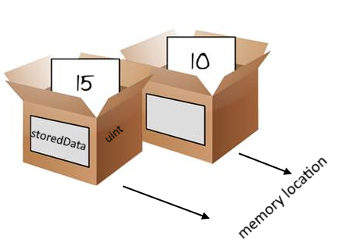

Variables
Declaration
You can think of variables as a named location in the computer’s memory.
The uint256 is the size of the location
And you can place some value into the named location.
assignment

Slide 7
Contract
A contract consists of the following multiple constructs:
State variables
Structure definitions
Modifier definitions
Event declarations
Enumeration definitions
Function definitions
A typical contract can consist of all the preceding constructs

Slide 8
Function
A function is a reusable group of code that can be called within the program.
With the help of functions, a program can be divided into many small pieces of code for better understanding and managing.
In Solidity a function is generally defined by using the function keyword, followed by the name of the function which is unique and does not match with any of the reserved keywords.
A function can also have a list of parameters containing the name and data type of the parameter. The return value of a function is optional

Slide 9
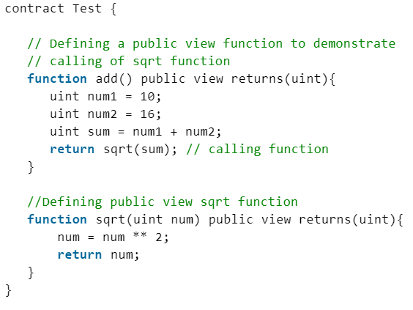
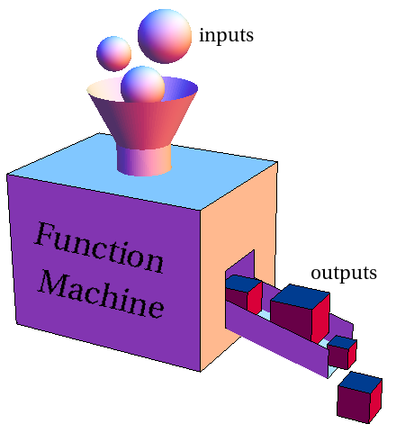
Function
parameters
returns

Slide 10
State Variables
Variables in programming refer to storage location that can contain values.
These values can be changed during runtime.
The variable can be used at multiple places within code, and they will all refer to the value stored within it.
Solidity provides two types of variable— state and memory variables.
State variables are permanently stored in a blockchain/Ethereum ledger by miners.
Variables declared in a contract that are not within any function are called state variables.

Slide 11
State Variables
The allocated memory for a state variable is statically assigned and it cannot change (the size of memory allocated) during the lifetime of the contract.
Each state variable has a type that must be defined statically – meaning defined prior to the program execution and can’t be changed at execution.
The Solidity compiler must ascertain the memory allocation details for each state variables and so the state variable data type must be declared.

Slide 12
State Variables
State variables also have additional accessibility qualifiers associated with them:
internal – accessible by derived contracts as well
private – accessible within the contract only
public – accessible outside the contract
constant – makes it immutable
State variables also have additional qualifiers associated with them (data types):
bool, uint, address, mapping, enum, struct, bytes, string

Slide 13
Data Types
Solidity data types can broadly be classified in the following two types:
Value types
Reference types
Assigning a variable to another variable can be done by creating a new copy or just by copying the reference that points back to the original variable
Value types maintains independent copies of variables and changing the value in one variable does not affect value in another variable.
Changing values in reference type variables ensures that anybody referring to that variables gets updates value.

Slide 14

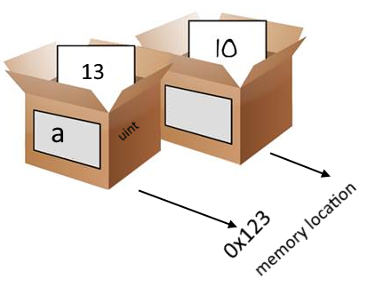
Value Types
A type is referred as value type if it holds the data (value) directly within the memory owned by it.
Example: a variable of data type unsigned integer (uint) is declared with 13 as its data(value).
The variable a has memory space allocated by EVM which is referred as 0x123 and this location has the value 13 stored.
Accessing this variable will provide us with the value 13 directly.

Slide 15
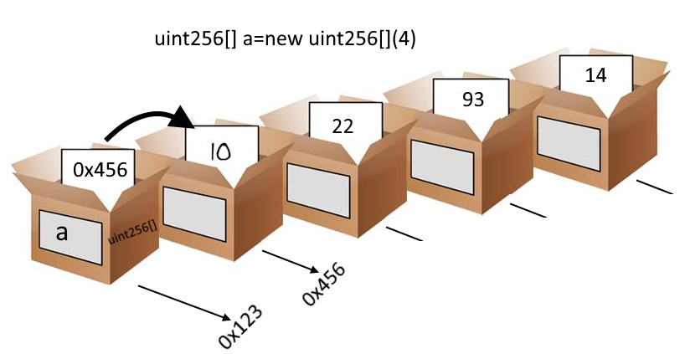
Reference Types
Reference types, unlike value types, do not store their values directly within the variables’ memory address.
Instead of the actual value, they store the address of the location where the actual value is stored. The variable holds the pointer to another memory location that holds the actual data.
Arrays, Structs, String and Mappings are reference types

Slide 16
Data locations
Storage: This is global memory available to all functions within the contract. This storage is a permanent storage that Ethereum stores on every node within its environment.
Memory: This is local memory available to every function within a contract. This is short lived and fleeting memory that gets torn down when the function completes its execution.
Calldata: This is where all incoming function execution data, including function arguments, is stored. This is a nonmodifiable memory location.
Stack: EVM maintains a stack for loading variables and intermediate values for working with Ethereum instruction set. This is working set memory for EVM.

Slide 17
Data locations
We can change data location only for parameters of functions and local variables in function.
Whenever a storage reference is casted to memory, a copy is made, and further modification on the object does not propagate back to contract state.
Storage cannot be newly created in a function.
Any storage referenced variable in a function always refers a piece of data pre-allocated on the contract storage (state variable)

Slide 18
Data locations
Variables declared as state variables are always stored in the storage data location.
Variables declared as function parameters are always stored in the memory data location.
Variables declared within functions, by default, are stored in memory data location unless it is a reference type then it is stored in storage but can be overridden to be in memory
Reference types declared within a function without being overridden should always point to a state variable.
Value type variables declared in a function cannot be overridden and cannot be stored at the storage location.
Mappings are always declared at storage location. This means that they cannot be declared within a function.

Slide 19
Data Locations
Arguments supplied by callers to function parameters are always stored in a calldata data location

Slide 20
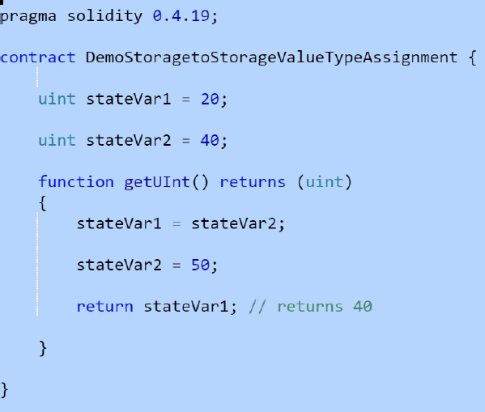
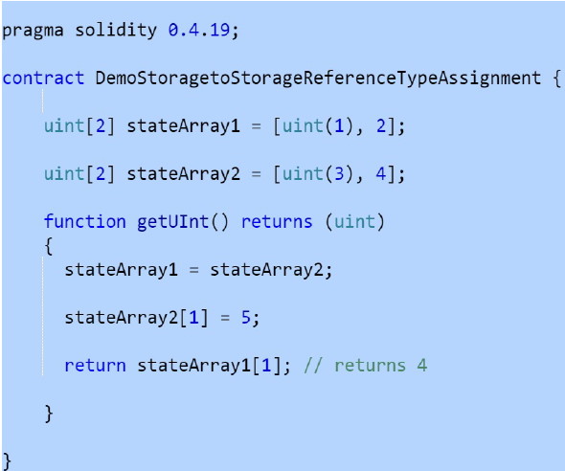
Data Locations
Assignments to state variable from another state variable always creates a new copy even if it is reference type

Slide 21
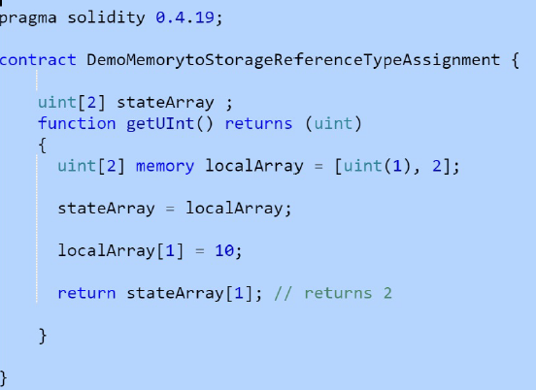
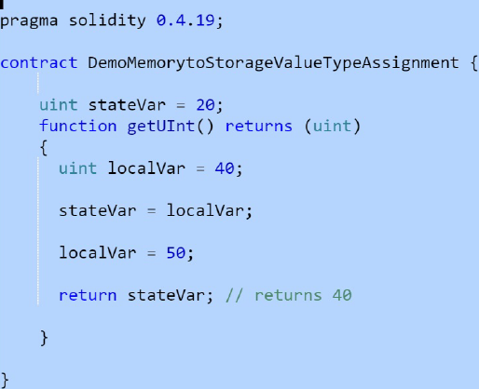
Data Locations
Assignments to storage variables from another memory variable always create a new copy.

Slide 22
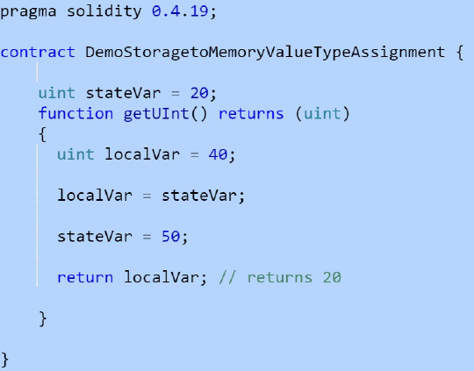
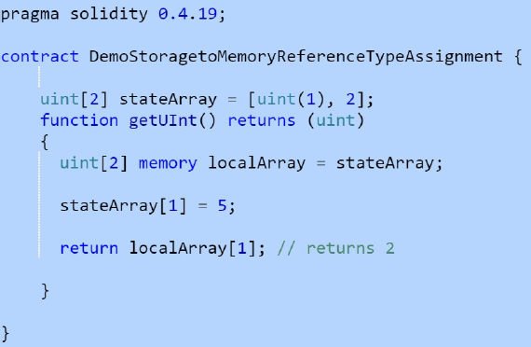
Data Locations
Assignments to memory variable from another state variable always creates a new copy.

Slide 23
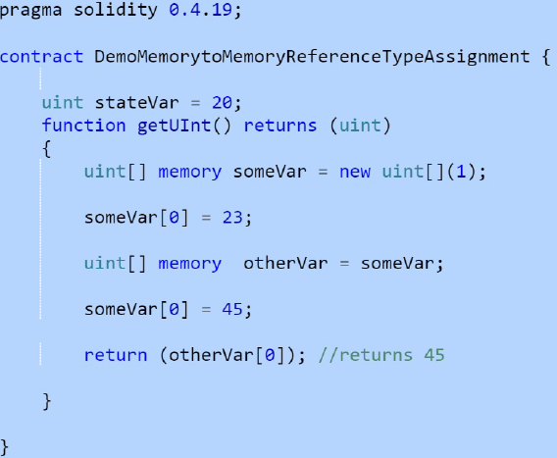
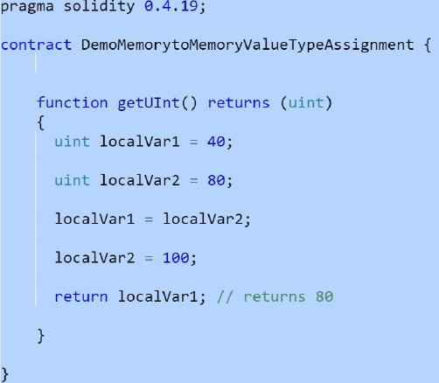
Data Locations
Assignments to a memory variable from another memory variable do not create a copy for reference types; however, they do create a new copy for value types

Slide 24
Mappings
Mappings are one of the most used complex data types in Solidity.
Mappings are similar to hash tables or dictionaries in other languages. They help in storing key-value pairs and enable retrieving values based on the supplied key.
Mappings are declared using the mapping keyword followed by data types for both key and value separated by the => notation.
Mappings have identifiers like any other data type and they can be used to access the mapping.
An example of mapping is as follows:

Slide 25
Mappings
Mappings can only have a data location of storage and thus are allowed for state variables, as storage reference types in functions, or as parameters for library functions.
They cannot be used as parameters or return parameters of contract functions that are publicly visible.
These restrictions are also true for arrays and structs that contain mappings.
Mappings can be seen as hash tables which are virtually initialized such that every possible key exists and is mapped to a value whose byte-representation are all zeros

Slide 26
Mappings
They are declared like this:
mapping (<Key_Type> => <Value_Type>) <variable>
the uint data type is used for storing the keys
the address data type is used for storing the values.
Names is used as an identifier for the mapping.
A value from mapping can be retrieved if the key is known.

Slide 27
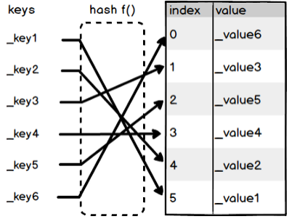
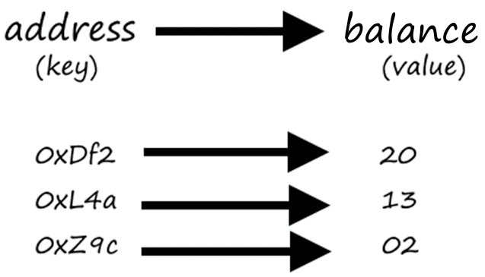
Mappings
Mappings are frequently used to associate unique Ethereum addresses with associated value types
The key data is not stored in a mapping, only its keccak256 hash is used to look up the value.

Slide 28
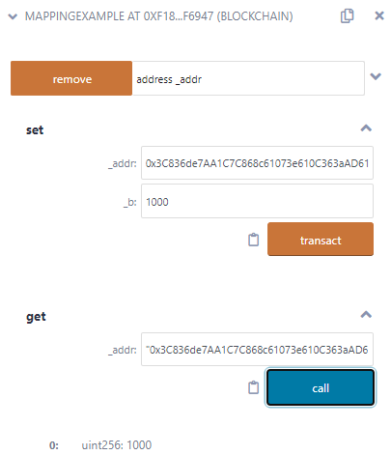
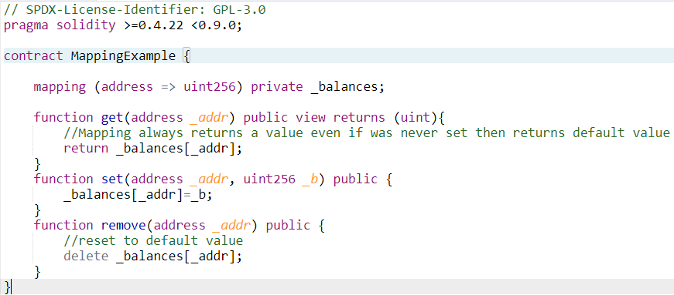
Mappings
https://ropsten.etherscan.io/tx/0x6025a0985098b8e3e0eb142f8989ef5258515fdc3e305fdc2c61c7ec4947b90a

Slide 29
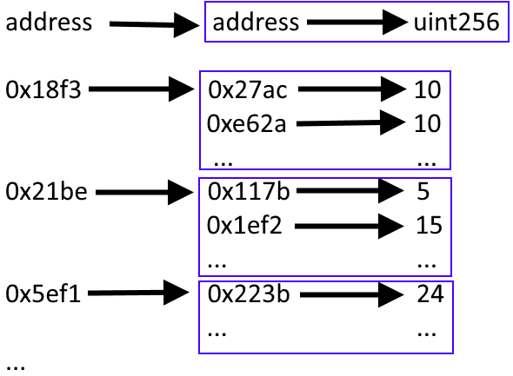
Mapping of Mapping

Slide 30
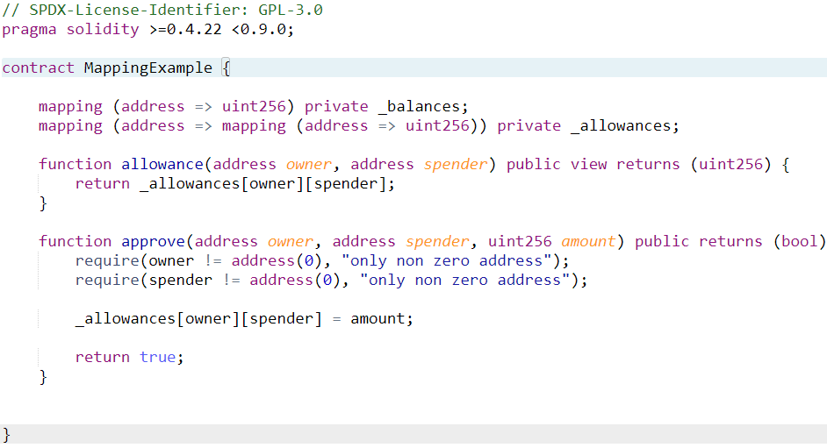
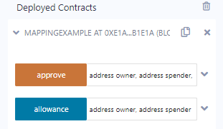
Mapping of Mapping
https://ropsten.etherscan.io/tx/0x21e4d8873585409680a4d3b8dbb15f6afb843dc3838a6a37d97a8da1f717d71e

Slide 31
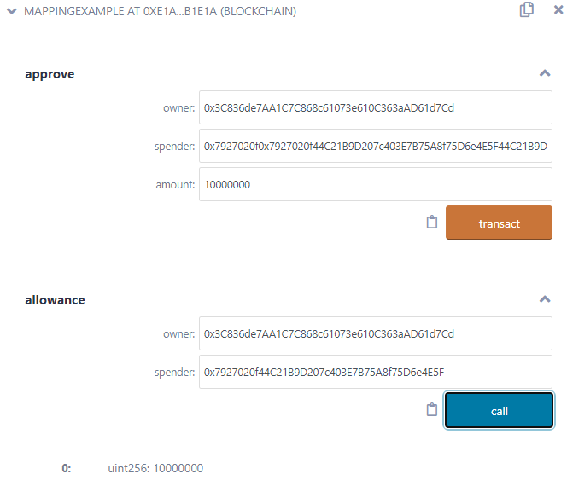
Mapping of Mapping

Slide 32
Events
Smart contract code runs on each EVM across the Ethereum network. It is essentially server-side code. One of the difficulties you encounter when running server-side code is communicating with the client.
Smart contracts don’t just run arbitrarily — they have to be called by a client or another smart contract
Solidity Smart Contract can emit events so that whoever is interested in handling them can listen for it.
If your calling program is waiting, or listening, for these events, it can respond to the events and carry out some of its own functions
Publishing events allows the called programs to communicate asynchronously with any listening programs. Programs that want to listen for, and respond to, events must subscribe to those events
Events are convenience interfaces with the EVM logging facilities.

Slide 33
Events
Applications can subscribe and listen to these events through the RPC interface of an Ethereum client.
Events are inheritable members of contracts. When you call them, they cause the arguments to be stored in the transaction’s log - a special data structure in the blockchain.
These logs are associated with the address of the contract, are incorporated into the blockchain, and stay there as long as a block is accessible (forever as of now, but this might change with Serenity).
The Log and its event data is not accessible from within contracts (not even from the contract that created them).

Slide 34
Events
There are three steps to implanting events in Solidity:
Define the event.
Use the Solidity event statement to define the event, give it a name, and define the data it passes when it triggers.
Trigger the event.
Use the Solidity emit statement to trigger a previously defined event and pass data to it.
Receive and respond to the event. A javascript library web3 can be used to subscribe to the event.
Example Events:
https://etherscan.io/address/0x06012c8cf97bead5deae237070f9587f8e7a266d#events

Slide 35
Events
Events are declared by using the event keyword, followed by an identifier and the parameter list, and ends with a semicolon.
The parameter values are used to log the information or for executing the conditional logic.
Its information and values are saved as part of the transactions inside the block.
There is no need of providing variables, only datatypes are sufficient.
An event can be called from any method by using its name and passing the required parameters.
event <eventName>(parameters) ;

Slide 36
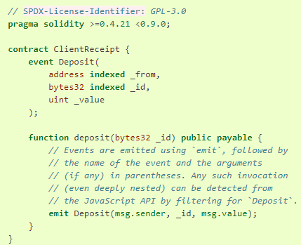
Events
Retrieving Events is done at the web3 level not at Solidity.
web3.js is a collection of libraries that allow you to interact with a local or remote ethereum node using HTTP, IPC or WebSocket

Slide 37
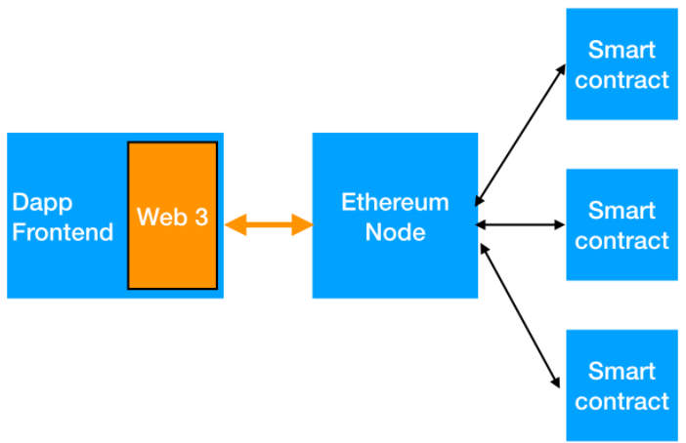
web3
web3.js is a collection of libraries that allow you to interact with a local or remote ethereum node using HTTP, IPC or WebSocket
Web3 provider is a website running geth or parity node which talks to Ethereum network.

Slide 38
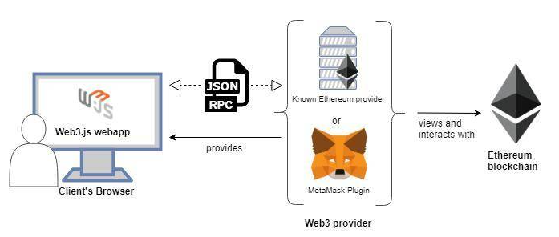
web3
Metamask allows the web provider end points (the path for connecting to an Ethereum client node) to be injected into the browser.

Slide 39
Contracts with Inheritance
Solidity inheritance lets you re-use multiple contracts by inheriting functions through re-use of functions in the parent contracts.
The parent contracts are the ones from which child contracts re-use the functions. This is called inheritance.
Contracts that inherit function and data are called derived (or children) contracts.
Solidity inheritance expresses a parent-child relationships between contracts whereby child contract re-uses parent contract functions.
There are two types of inheritance: single and multi-level.

Slide 40
Inheritance
Inheritance is one of the key concepts in object-oriented programming.
One of the advantages of it is reduction in code. It also emphasizes the relationship between classes.
When one class (or contract) A inherits from class (or contract) B it is often the case A is a type of B. They are related except for some details.
A is called the derived class and B is the based class. All the capabilities of B are inherited to A.
In addition, A has additional behavior of its own (for example more functions).
B is also sometimes called the Parent class and A the Child class.

Slide 41
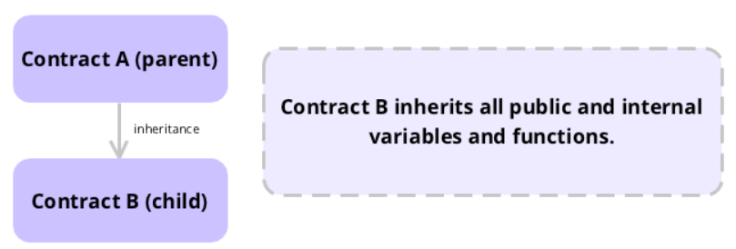
Single Inheritance
Single inheritance enables re-use of functions, modifiers, events and variables from the parent to the child.

Slide 42
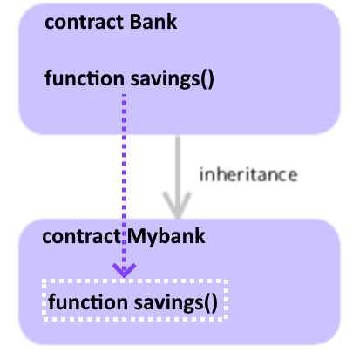
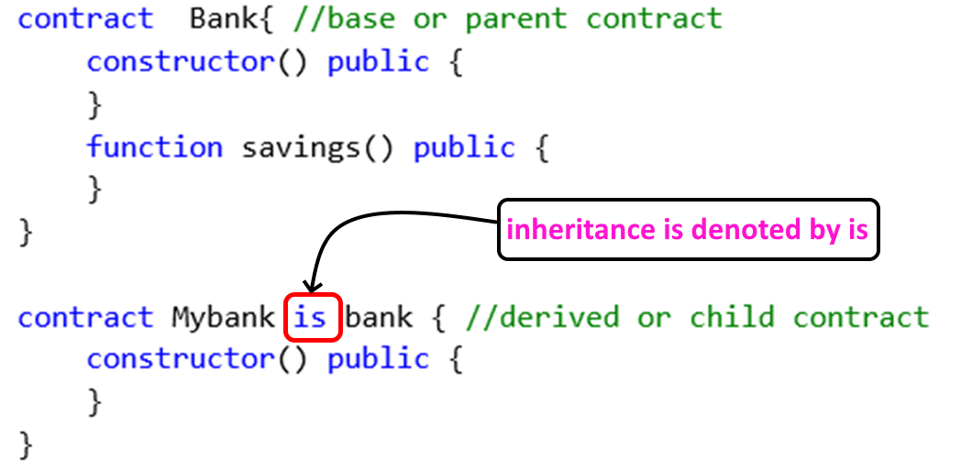
Single Inheritance
Because Mybank is the child contract, it inherits the saving function
Mybank contract can call the savings function.

Slide 43
Inheritance
It is possible to call functions further up in the inheritance hierarchy internally by explicitly specifying the contract using ContractName.functionName() or using super.functionName() if you want to call the function one level higher up in the flattened inheritance hierarchy
State variable shadowing is considered as an error. A derived contract can only declare a state variable x, if there is no visible state variable with the same name in any of its bases.

Slide 44
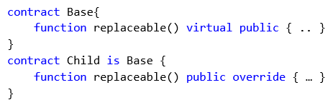
Function Overriding
A function in a parent contract can be replaced (“overridden”) in the inheriting contract if they are marked as virtual. The overriding function in the inheriting contract must mark that function using the override keyword in the function header.

Slide 45
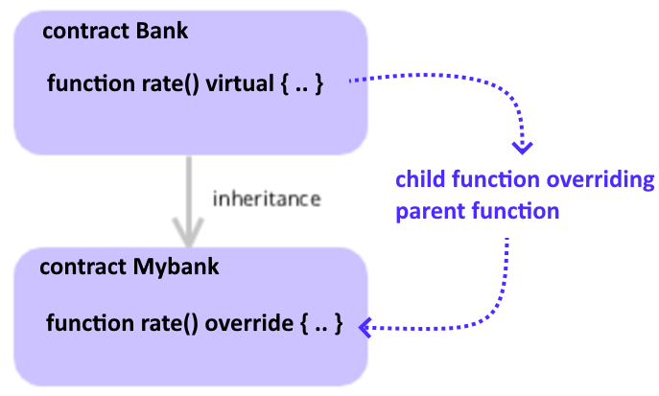
Virtual Functions
The Mybank contract can define its own savings function overriding the parent’s function if the parent function has been marked virtual.
If you do not mark a function that overrides as virtual, derived contracts can no longer change the behaviour of that function.

Slide 46
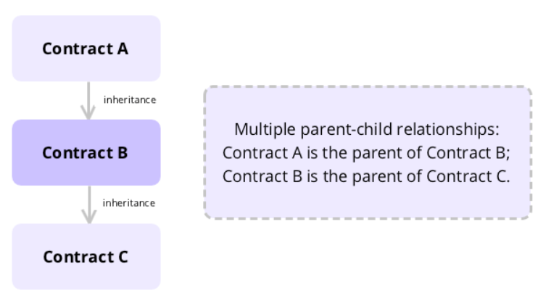
Multi-level inheritance
Multi-level inheritance generates more than one parent-child relationship

Slide 47
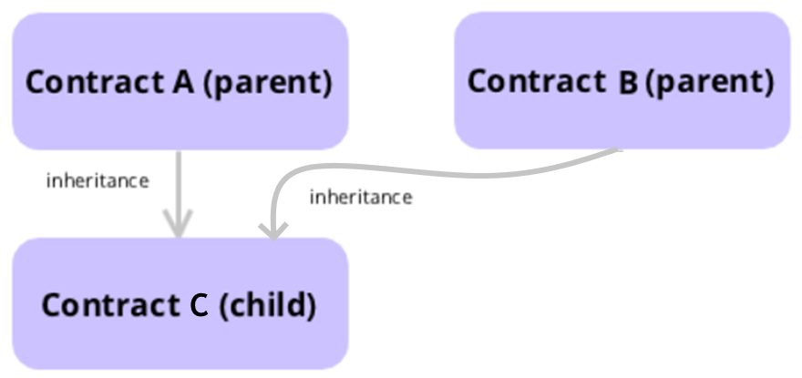
Multiple Inheritance
Multiple inheritance is the case when a derived contract has more than one base class.
Where a child contract can have more than one parent
What happens when the function or data have the same name?
Solidity follows C3 Linearization in which the order of execution is determined by the order of the declaration at the contract level

Slide 48
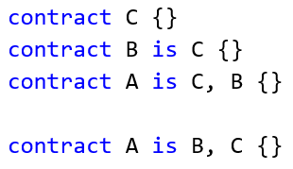
Multiple Inheritance
Functions and Data from A and B are available for use in C
Multiple inheritance can cause conflict in deciding which properties and behavior to inherit.
Solidity solves this by disallowing some inheritance according to a specific linearization rule.
You have to list base contracts from most base-like to more derived.

Slide 49
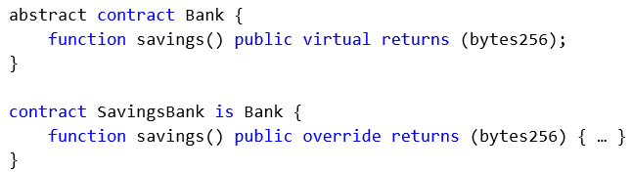
Abstract Contracts
Contracts need to be marked abstract if at least one of their functions is unimplemented, that is, it only has the function signature without a function code body.

Slide 50
Interfaces
Interfaces are like abstract contracts except they can not have any functions implemented.
Interfaces cannot inherit from other contracts but can inherit from interfaces. However, contracts can inherit interfaces.
All functions have to be declared as external. Constructors and state variables are not allowed.

Slide 51
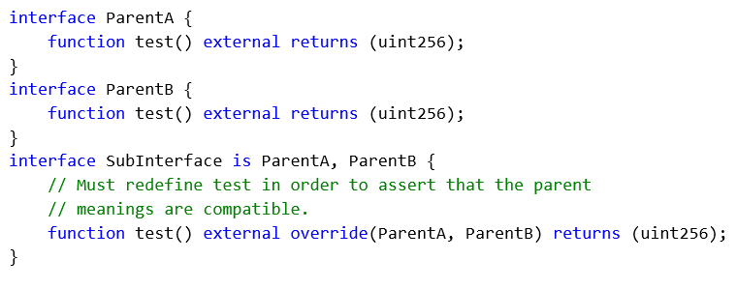
Interface

Slide 52
Initialization and Constructors
Contracts can have an optional function called constructor().
In cases when contracts do not have Solidity constructors, they take the default constructor which is the same as the empty constructor() public {}
This function executes after contract creation, where it is possible to run contract initialization code.
State variables are set to their indicated value when you perform initialization. This process happens before constructor runs.
Once the Solidity constructor executes, the finished code of the contract moves to the blockchain.

Slide 53
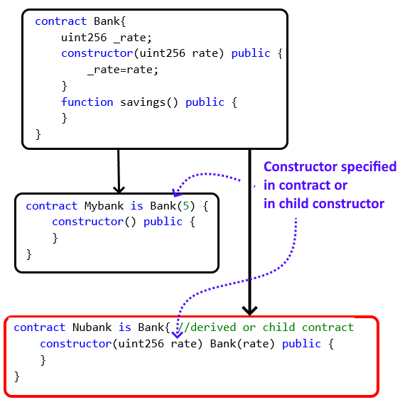
Inheritance and Constructors
If the base constructors have arguments, the derived contract constructor must specify it.

